Slide 1

ENHANCING INSTAGRAM ENGAGEMENT THROUGH DATA-DRIVEN MARKETING
BY KISHORE B.G
FROM NEWTON SCHOOL

Slide 2
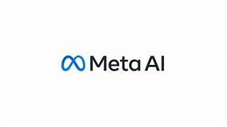
INTRODUCTION
“Behind every like, comment, and follow is a story waiting to shape our next strategy.”
Here,
Various sets of insights and visualizations are available that would be helpful for us to develop targeted marketing strategies that will increase user engagement, retention, and acquisition.

Slide 3
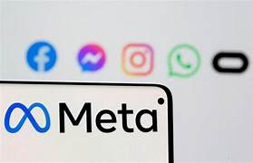
Problem statement
You are hired as a data analyst at Meta and asked to collaborate with Marketing team. Marketing teams wants to leverage Instagram's user data to develop targeted marketing strategies that will increase user engagement, retention, and acquisition. Provide insights and recommendations to address the following objectives

Slide 4
DATA OVERVIEW
comments_id : unique identifier for each comment
comment_text : text content of a given comment
user_id : unique identifier for each user
photo_id : unique identifier for each photo
created_at : date of interaction in the form like, photos, tags
follower_id : user_id of the follower for a certain user
followee_id : user_id of followee for a certain user
tag_id : unique identifier for each tag
image_url : link to the image posted on the platform
username : username chosen by the user
DATABASE LINK:https://drive.google.com/file/d/1wSXXQboFYXgJXxccj4i-cKfIX5QtdPwH/view?usp=drive_link

Slide 5
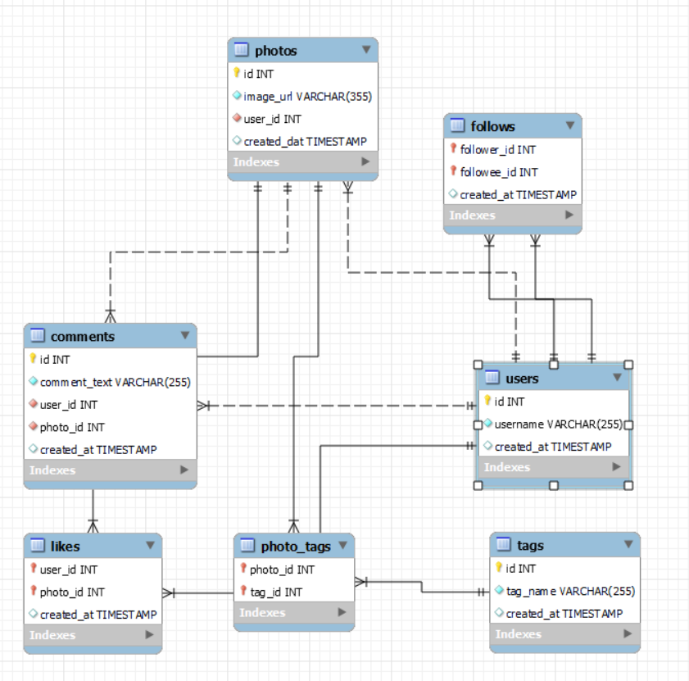
DataBase Schema

Slide 6
USERS WITH TOP ENGAGEMENT RATES IN LIKES AND COMMENTS

Slide 7
OBSERVATION
1. High Engagement Doesn’t Always Correlate with High Post Volume
Some users with fewer posts had exceptionally high engagement rates, indicating that quality and relevance of content matter more than quantity.
2. Micro-Influencers Show Stronger Per-Post Engagement
Users with moderate follower counts and consistent content often had higher engagement rates per post than those with large follower bases.
These "micro-influencers" typically have more loyal and interactive audiences.
3. Comments Boost Rankings
Users receiving more comments ranked higher in engagement rate compared to those who primarily received likes.
Comments indicate deeper interaction, possibly reflecting better content quality or community engagement.

Slide 8
TAG WISE ENGAGEMENT RATE

Slide 9
INSIGHTS REGARTING HASHTAG & TOPIC ENGAGEMENT
Insights on Hashtag & Topic Engagement
High-Engagement Hashtags Are Often Trend-Aligned
Instead of broad hashtags like #photo, more specific ones like #sunsetphotography or #homeworkouts tend to foster stronger communities and higher engagement.
Emotional and Relatable Content Drives More Interaction
Posts under topics that are inspirational (#selflove, #mentalhealth), humorous, or personally relatable get more comments and shares.
Visually Rich Topics Attract More Likes
Topics like travel, food, fashion, and art consistently draw attention due to their aesthetic appeal.
Hashtags like #TravelGoals, #Foodie, or #OOTD (Outfit of the Day) often show higher like-per-post ratios.

Slide 10
RECOMMENDATIONS
RECOMMENDATIONS:
Optimize Hashtag Use
Use a mix of high-engagement hashtags and trending topics to increase discoverability.
Avoid overused or generic tags that might bury the content.
Design Ads Around High-Performing Topics
For example, if #homeworkouts has a high engagement rate, fitness brands can craft targeted ads or reels using that hashtag and related visuals.
This ensures the content aligns with what the audience is already engaging with.
Collaborate with Niche Influencers
Influencers within high-engagement topic areas often have more engaged audiences than general celebrities.
Partnering with them boosts authenticity and effectiveness of ad campaigns.

Slide 11
CRUCIAL PLAY OF POSTING HOURS IN THE ENGAGEMENT OF THE RATE OF USERS

Slide 12
INSIGHTS ON POSTING HOURS AND ENGAGEMENT RATE
INSIGHTS ON POSTING HOURS AND ENGAGEMENT RATE:
Evening Hours (6 PM – 9 PM): Peak Engagement Window
This is consistently the time when users are most active. People tend to unwind after work or school, scroll through social media, and engage more freely.
Posts shared during this period often receive the highest number of likes and comments.
Morning Activity (7 AM – 9 AM): Secondary Peak
Many users check their phones during morning routines—commuting, breakfast, or before starting their day. Engagement is not as high as the evening, but timely, motivational, or informative content performs well here.
Midday (12 PM – 2 PM): Steady But Competitive
Lunch breaks are another key browsing time. Although engagement is decent, it’s often spread out across many posts, so standing out is more difficult unless content is highly engaging or relevant.
Late Night (10 PM – 2 AM): Low Engagement
While some users browse late at night, overall interaction drops. Posts at this time may receive fewer comments or likes unless targeted toward a night-active audience (e.g., students, nightlife).
Early Morning (2 AM – 6 AM): Minimum Activity
This is the least effective time to post for most regions.Content posted here often gets buried under the following day’s activity.

Slide 13
Recommendations for Content Strategy
RECOMMENDATIONS:
Schedule Posts for Prime Engagement Hours
Focus on posting between 6 PM and 9 PM to maximize interaction.
Use automated scheduling tools to maintain consistency during these windows.
Time Content Type to Match the Audience Mood
Morning: Share inspirational posts, tips, or bite-sized news.
Evening: Use emotionally resonant, entertaining, or community-driven content.
Avoid Posting During Off-Hours
Content posted during late night or early morning often underperforms, unless targeting specific time zones or audience segments.

Slide 14
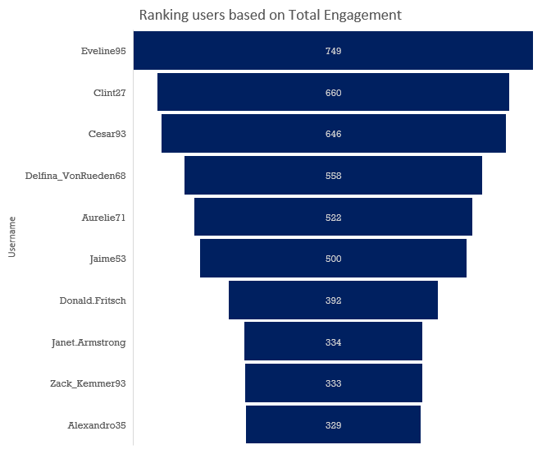
RANKING USERS BY TOTAL ENGAGEMENT

Slide 15
OBSERVATIONS
Engagement Rate:
Use the formula: Engagement Rate = (Likes + Comments) / Total Followers
This tells us how actively they are engaged with their audience.
Segmentation by Engagement Level
We must use metrics such as total likes, comments,
and posts to classify users:
Segment Name | Criteria
Highly Engaged | Users with high number of likes & comments received per post
Moderately Engaged | Users with moderate interactions on posts
Low Engaged / Lurkers | Users who rarely receive or give likes/comments

Slide 16
CATEGORIZING USERS BASED ON ENGAGEMENT LEVELS

Slide 17
VARIETIES OF SEGMENTATIONS
Segmentation by Engagement Level
We must use metrics such as total likes, comments, and posts to classify users:
Segment Name | Criteria
Highly Engaged | Users with high number of likes & comments received per post
Moderately Engaged | Users with moderate interactions on posts
Low Engaged / Lurkers | Users who rarely receive or give likes/comments
Recommended Campaign Strategies by Segment:
Segment | Personalized Campaign Ideas
Highly Engaged | Early access to new features, badges, or exclusive content
Creators | Highlight their posts, offer creator toolkits
Influencers | Collaborate for promotions, co-branded campaigns
Inactive Users | Email nudges, feed customization, or reactivation bonuses
Commenters | Promote discussion-focused content (e.g., questions, polls)
Observers | Show popular content, suggest topics based on past views

Slide 18
FINAL RECOMMENDATIONS
1. Optimize Hashtag & Content Strategy
Promote hashtags with the highest average engagement.
Since hashtag Drives higher interaction and visibility across posts.
2. Post Timing Optimization
Encourage users to post during peak engagement hours identified in the analysis.
Improves reach and user satisfaction by increasing interactions.
3. Personalize Marketing by User Segments
Use behavior-driven segments (e.g., Observers, Commenters, Creators) to tailor outreach.
Increases campaign effectiveness and reduces cost per engagement.
Create influencer programs, co-branded campaigns, and exclusive feature access.

Slide 19

“Social media is not just an activity; it is an investment of valuable time and resources.”

